Slide 1
Welcome !!
Don’t forget a name tag!
Grab a 🍻

Slide 2
Wifi information 💻
SSID: HWP-Guest
PASS: hardwarepark

Slide 3
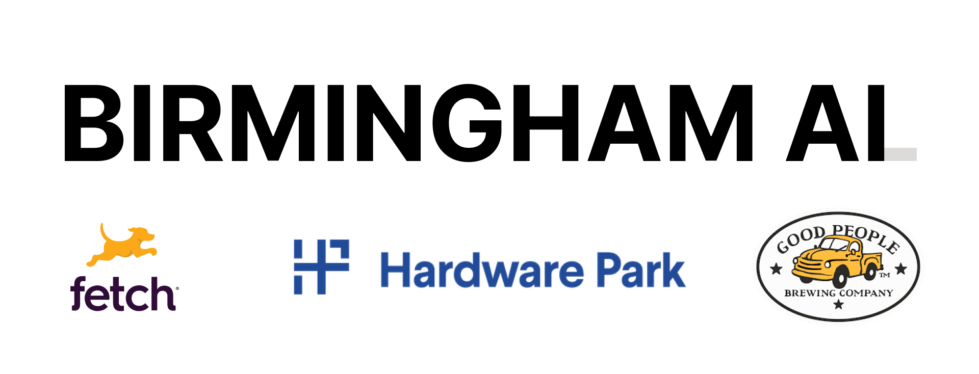
A word from our sponsors ❤️

Slide 4
tl;dr | What is this group?

Slide 5
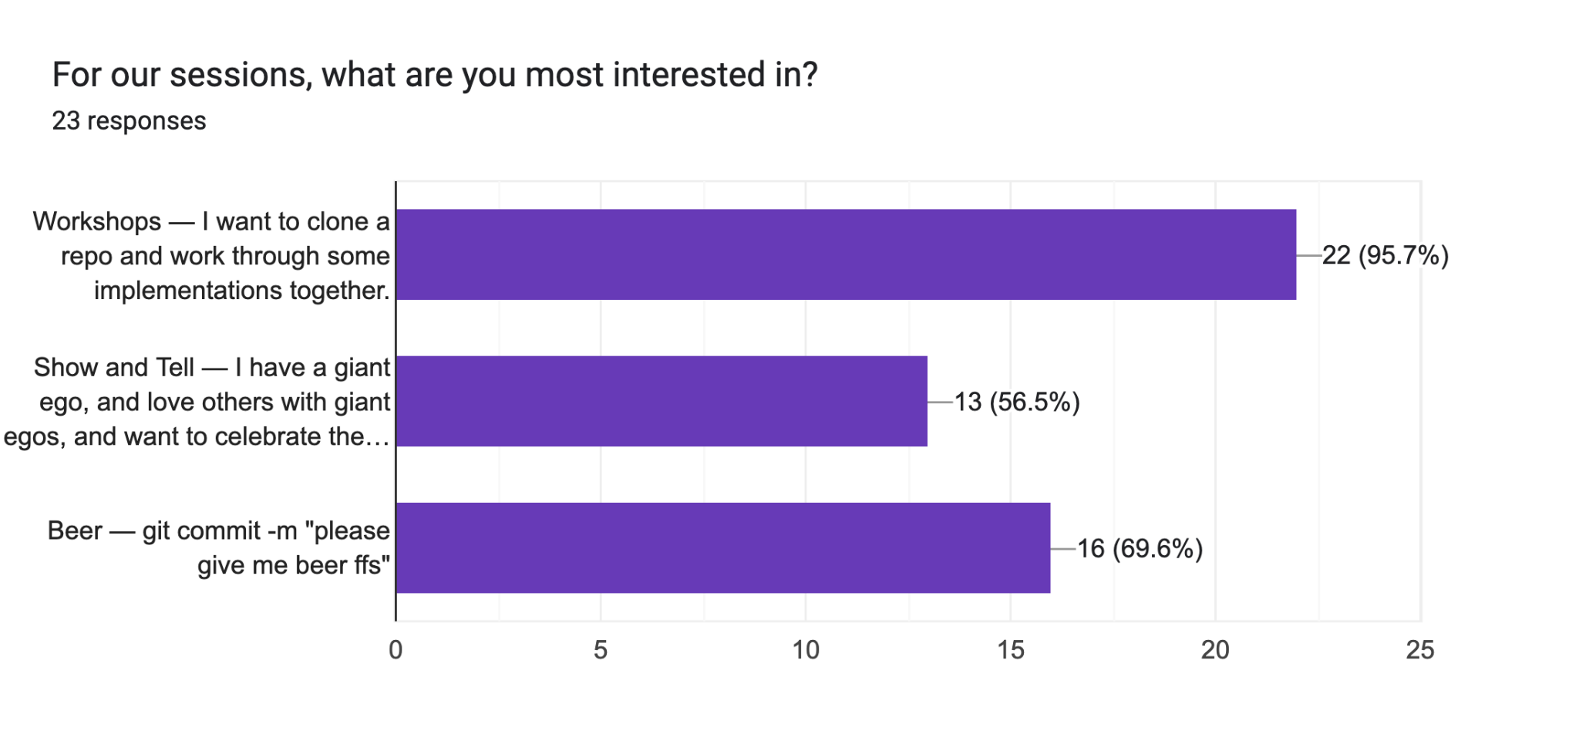
tl;dr | Why are we meeting?

Slide 6
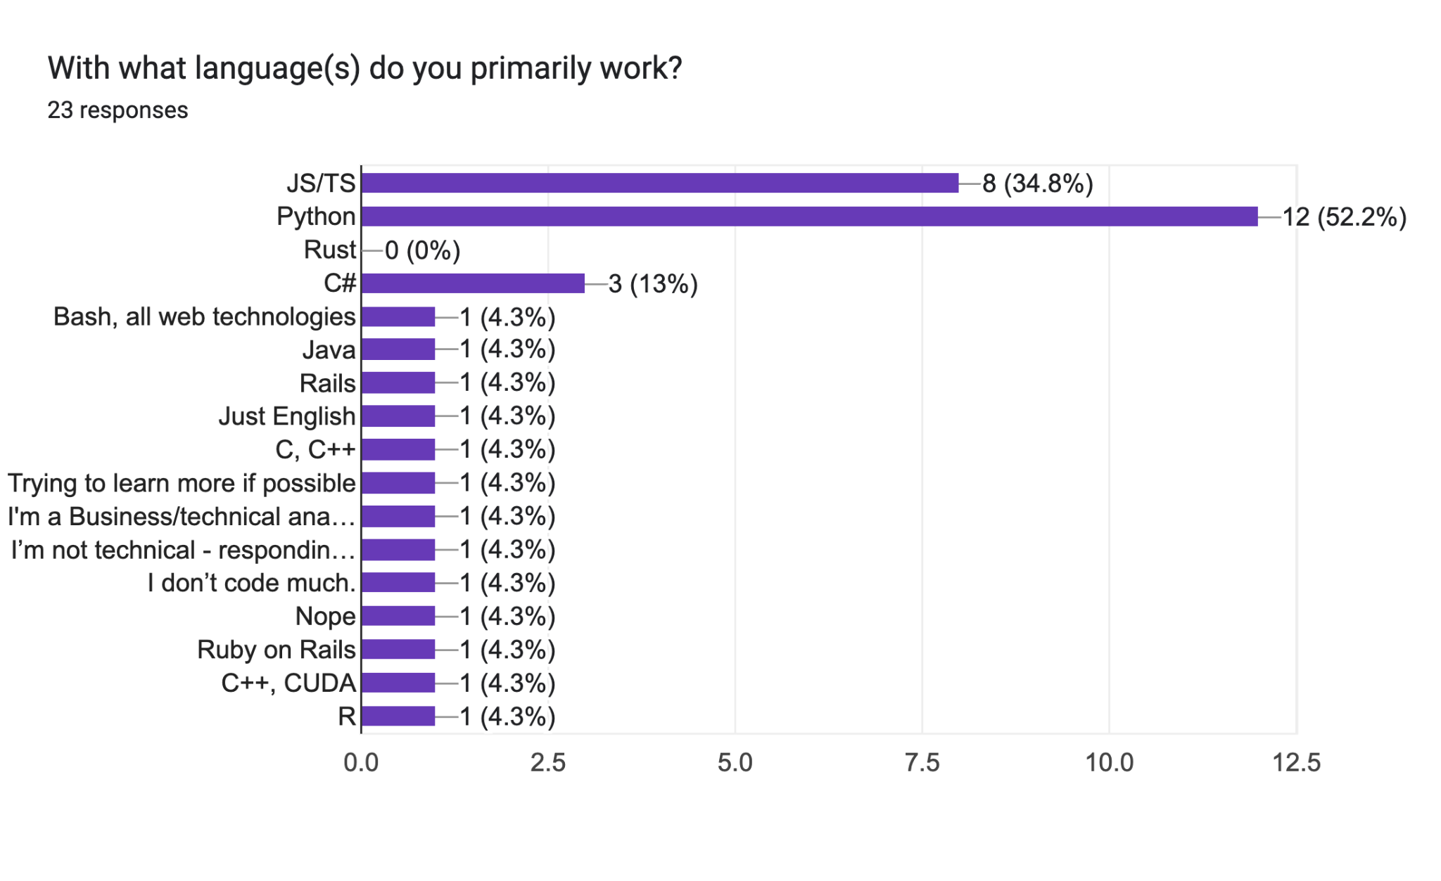
tl;dr | Why are we meeting?

Slide 7
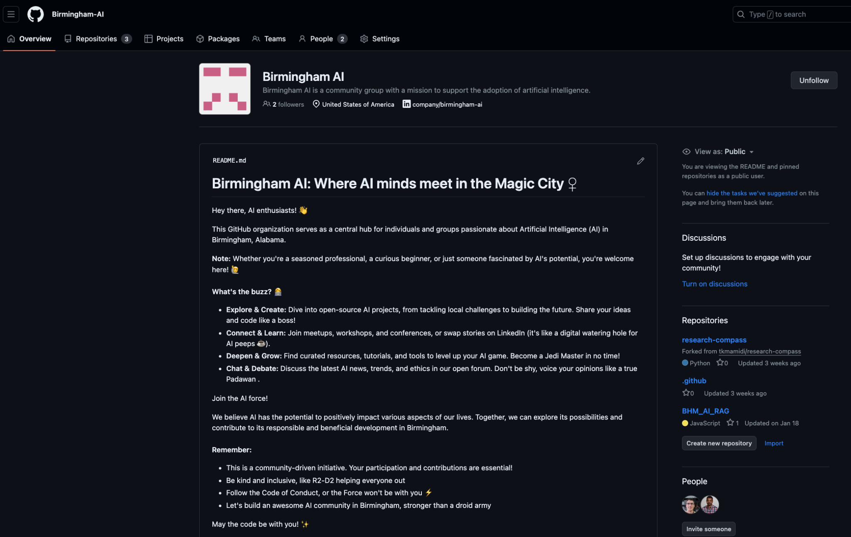

Slide 8
Developing AI apps with open-source no-code tools
(Empowering Innovation without writing code)
Yashwanth Mamidi
Senior Data Analyst
Pfizer

Slide 9
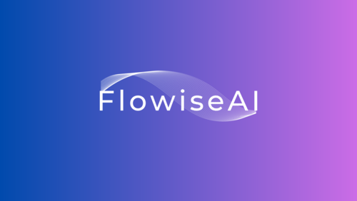
Agenda
Benefits of Using No-Code Tools
Why Flowise?
Getting Started with Flowise
Integrate chatbot to websites

Slide 10
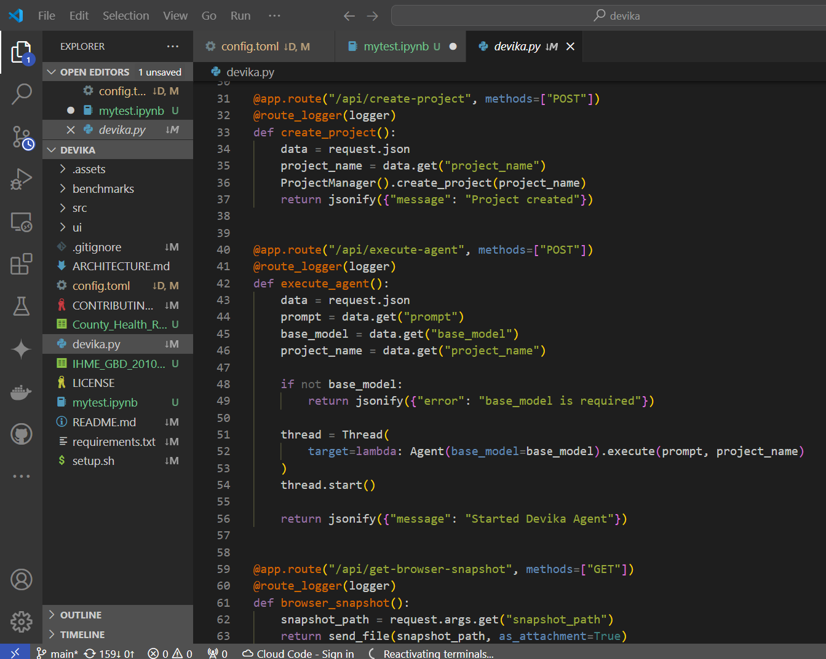
Benefits of Using No-Code Tools
Empowers Non-Developers:
Enables business users to create solutions without coding skills.
Speed and Efficiency:
Rapid prototyping and deployment.
Cost-Effective:
Reduces the need for extensive development resources.
Flexibility and Adaptability:
Easy to modify and iterate on workflows.

Slide 11
Why Flowise?
A no-code & open-source platform for developing AI applications
Visual Workflow Builder:
Drag-and-drop widgets for creating workflows
Pre-Built Integrations:
Integrates with popular frameworks (e.g. LangChain) and vector stores (e.g. Chroma DB)
Customizable Templates:
Ready-to-use templates for AI agentic workflows

Slide 12
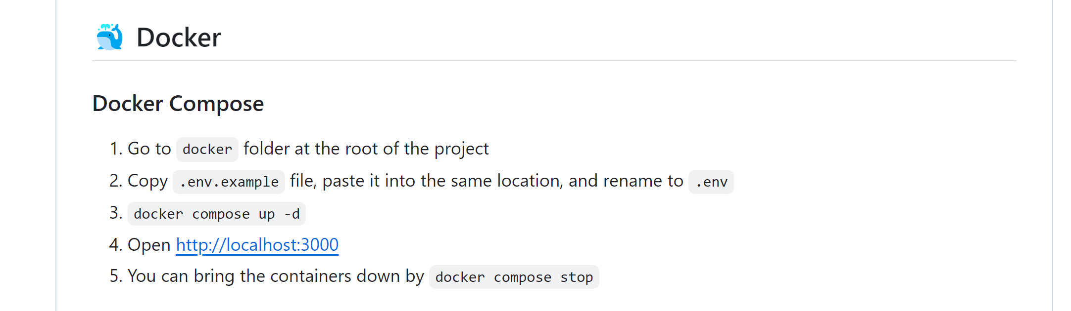
Getting Started with Flowise
Clone the Flowise repo (https://github.com/FlowiseAI/Flowise.git)
Compose with Docker
https://github.com/FlowiseAI/Flowise

Slide 13
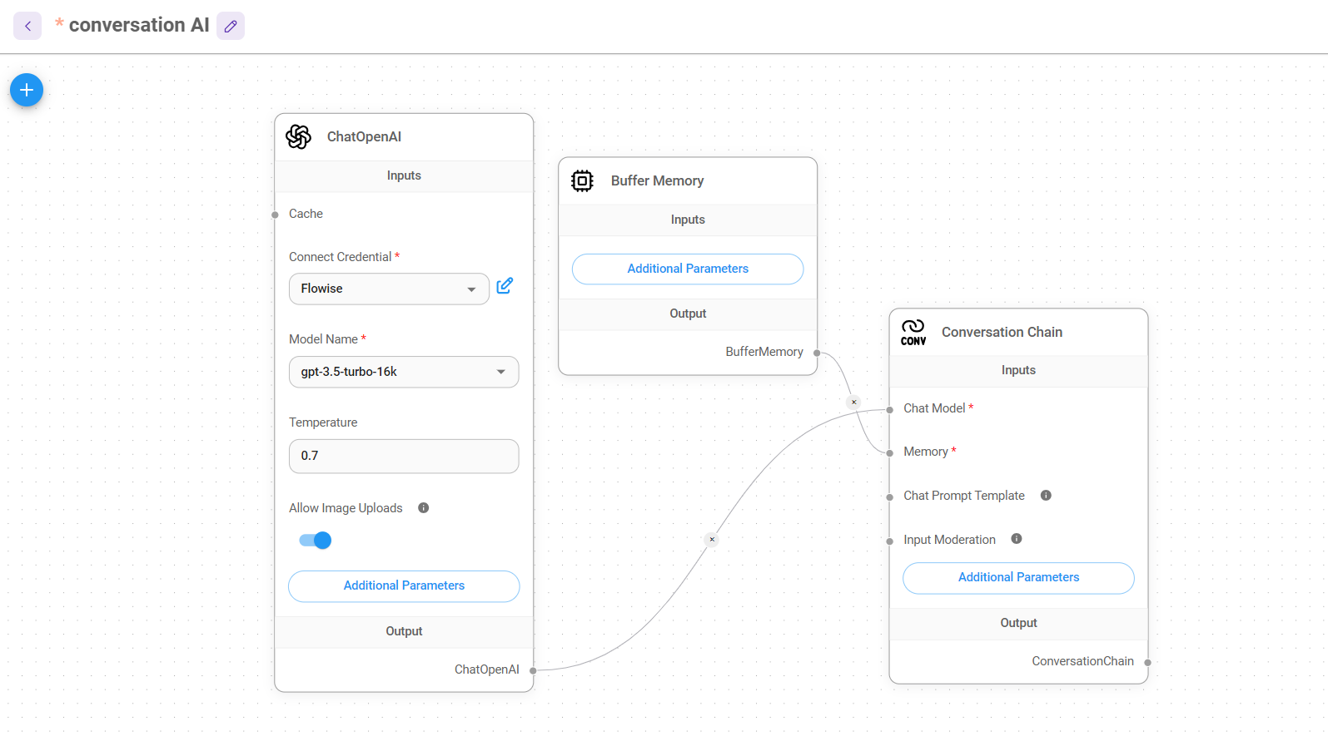
Flowise

Slide 14
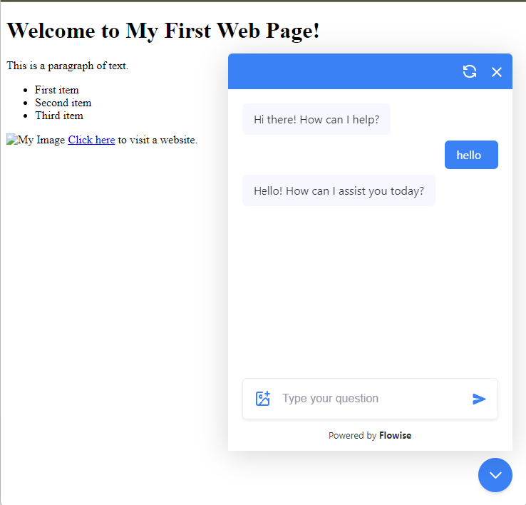
Integrate in webpage

Slide 15

Interested in facilitating our next event?! 🔥
We’re looking for volunteers!

Slide 16
See you at the next event…
Thanks for coming!

